Slide 1
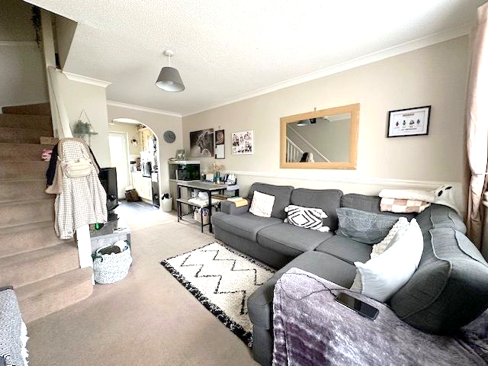
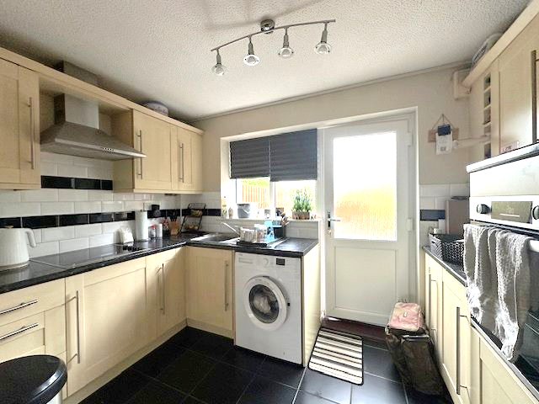
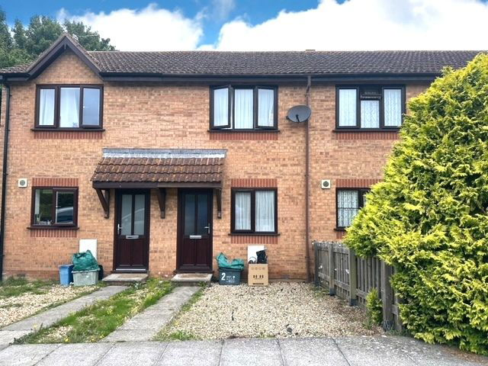
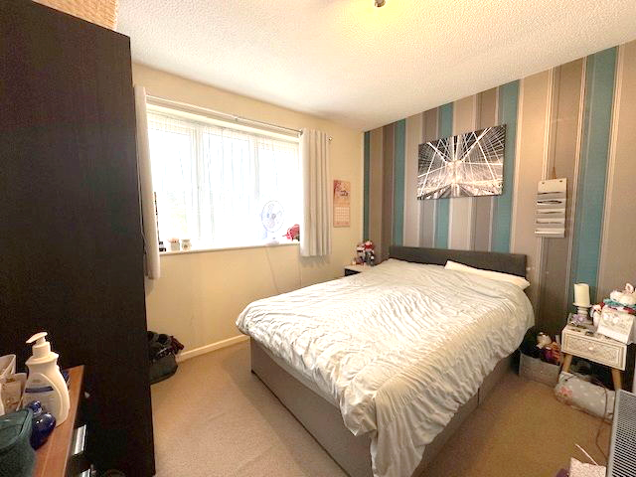
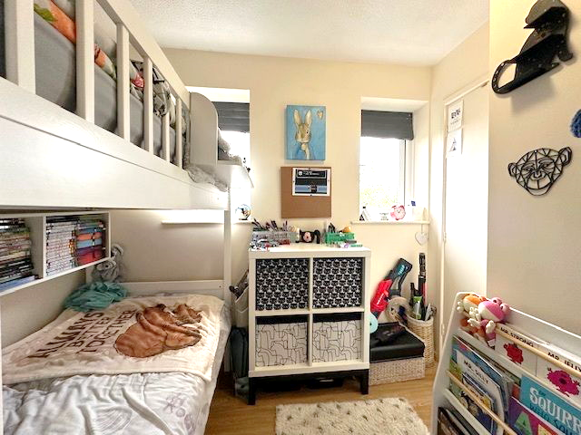
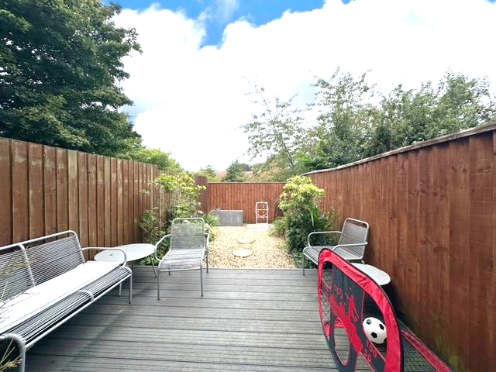
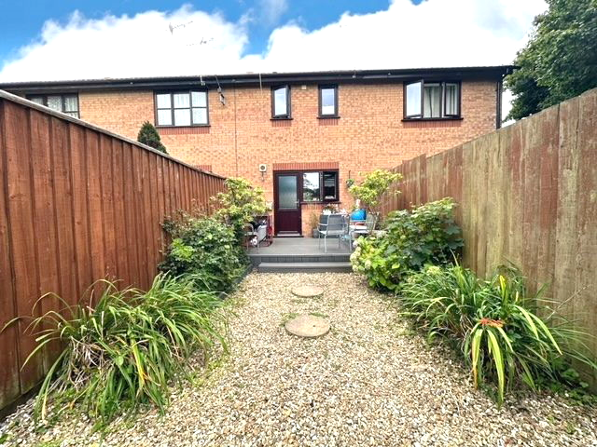
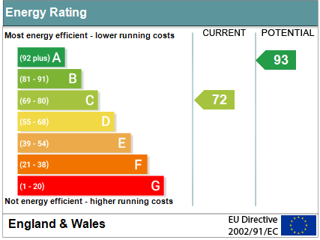
www.pennys.net
2 Nursery Close, Exmouth, EX8 3RE
GUIDE PRICE £225,000
TENURE Freehold
A Well Presented Two Bedroom Terraced House Situated Within Walking Distance To Bus Routes, Amenities & Schools Offered For Sale With No Onward Chain
Lounge * Kitchen * Two First Floor Bedrooms * First Floor Family Bathroom * Separate First Floor Cloakroom/Wc * Enclosed Rear Garden * Off-Road Parking * Ideal First Time Purchaser/Investment * No Onward Chain
Pennys Estate Agents Limited for themselves and for the vendor of this property whose agents they are give notice that:- (1) These particulars do not constitute any part of an offer or a contract. (2) All statements contained in these particulars are made without responsibility on the part of Pennys Estate Agents Limited. (3) None of the statements contained in these particulars are to be relied upon as a statement or representation of fact. (4) Any intending purchaser must satisfy himself/herself by inspection or otherwise as to the correctness of each of the statements contained in these particulars. (5) The vendor does not make or give and neither do Pennys Estate Agents Limited nor any person in their employment has any authority to make or give any representation or warranty whatever in relation to this property.
PENNYS ESTATE AGENTS
2 Rolle House, Rolle Street, Exmouth, Devon, EX8 2SN
Tel: 01395 264111 EMail: help@pennys.net

Slide 2
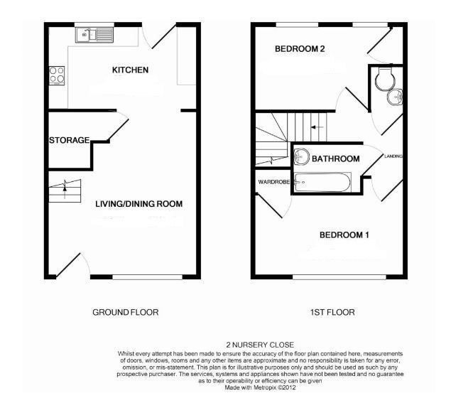
2 Nursery Close Exmouth, EX8 3RE
THE ACCOMMODATION COMPRISES: uPVC double glazed front door with pattern inset giving access to: LOUNGE: 4.98m x 3.25m (16'4" x 10'8") uPVC double glazed window to front aspect; electric night storage heater; dado rail; television point; telephone point; smoke alarm; stairs rising to FIRST FLOOR; useful understairs storage cupboard with power and light connected; archway opening through to: KITCHEN: 3.23m x 2.06m (10'7" x 6'9") Fitted with pattern work top surfaces and attractive tiled surrounds; range of base cupboards and drawer units with plumbing for an automatic washing machine beneath; inset stainless steel one and a quarter bowl sink unit with mixer tap; four ring ceramic hob with stainless steel extractor hood over; wall mounted cupboards; built-in electric oven; tiled floor; space for upright fridge freezer; extractor fan; uPVC double glazed window overlooking rear aspect; uPVC double glazed door with obscure glass opening onto GARDEN. FIRST FLOOR LANDING: Smoke alarm; doors to: BEDROOM ONE: 3.25m x 3.2m (10'8" x 10'6") Maximum overall measurement into door recess. uPVC double glazed window to front aspect; carpet; electric wall heater; cupboard over stairwell with hanging rail and shelving. BEDROOM TWO: 2.62m x 2.06m (8'7" x 6'9") Maximum overall measurement. Two uPVC double glazed windows to rear aspect; wood flooring; access to roof space via hatch; built-in cupboard with hanging rail and shelving. BATHROOM: 1.42m x 1.24m (4'8" x 4'1") Comprising of a bath with wall mounted Triton shower, glass splash screen and hanging rail for shower curtain; fully tiled walls; tiled floor; pedestal wash hand basin; wall mounted mirror fronted medicine cabinet; extractor fan; tiled floor. CLOAKROOM/WC: WC with push button flush; space saver wash hand basin with mixer tap; part tiled walls; tiled floor; extractor fan. OUTSIDE: To the front of the property there is hard standing parking area (No.2 owns the left hand side) outside storage unit, stoned area and pathway leading to the front door. The rear garden is fully enclosed via timber fencing with a decked area and stones edged with mature shrub beds.
FLOOR PLAN:

